Slide 1
NSU Campus Adventure
🎮
A Text-Based Adventure Game in C
💻 CSE115 – Programming Language I
Submitted To: M. Shifat-E-Rabbi
Dept. of Electrical and Computer Engineering
PRESENTER ORDER
1
👤 Smita Elizabeth Biswas
3
👤 Md. Shaharear Hossain Naffiz
2
👤 Sumaiya Karim Ilma
4
👤 Chowdhury Rounak Jahan Bushra
Group 1 - Md. Shaharear Hossain Naffiz | Chowdhury Rounak Jahan Bushra | Sumaiya Karim Ilma | Smita Elizabeth Biswas

Slide 2
STORYLINE & DESIGN
Presented By: Smita Elizabeth Biswas
📖 Storyline & Game Design
🎮 Genre: Text-Based Interactive Adventure Game
💻 Language: C (C99 Standard)
🎓 It's your first day at North South University. Navigate real NSU-inspired environments, make decisions, solve puzzles, and find your path as a new student!
SCENE FLOW
🚪
NSU Main
Gate
🏛
Academic
Building
📚
Central
Library
🎭
Club
Fair
🌳
NSU
Plaza
🧠 Game Design Concepts
🔢 Puzzle Integration
NSU-inspired real environments
Interactive scene-by-scene structure
Player choices determine outcome
Immersive first-person storytelling
Math & logic puzzles per scene
Answer validation with getValidChoice()
Wrong answers affect stats
Replayable branching decisions
Group 1 - Md. Shaharear Hossain Naffiz | Chowdhury Rounak Jahan Bushra | Sumaiya Karim Ilma | Smita Elizabeth Biswas

Slide 3
PROGRAM STRUCTURE
Presented By: Sumaiya Karim Ilma
⚙️ Program Structure
Function-based modular design — each scene is an independent, reusable function
🏗
🎯
🗺
Modular Functions
Actual Function List
Scene Architecture
Each scene is a self-contained void function.
Clear separation of concerns.
Easy to add or modify scenes independently.
void mainMenu();
void startGame();
void gate();
void academicBlock();
void libraryPuzzle();
void clubFair();
void plaza();
void showEnding();
int getValidChoice(int min, int max);
main() → mainMenu() → startGame()
→ gate() → academicBlock()
→ libraryPuzzle() → clubFair()
→ plaza() → showEnding()
main() ↓ mainMenu() ↓ startGame() ↓ Scenes ↓ showEnding()
Group 1 - Md. Shaharear Hossain Naffiz | Chowdhury Rounak Jahan Bushra | Sumaiya Karim Ilma | Smita Elizabeth Biswas

Slide 4
FLOWCHART & MENU
Presented By: Sumaiya Karim Ilma
📊 Flowchart & Menu System
ACTUAL MENU OPTIONS
PROGRAM FLOW
main()
1
Start New Game
mainMenu()
2
How to Play
startGame()
3
About This Project
gate() → academicBlock()
libraryPuzzle() → clubFair()
4
Exit
plaza()
showEnding()
Group 1 - Md. Shaharear Hossain Naffiz | Chowdhury Rounak Jahan Bushra | Sumaiya Karim Ilma | Smita Elizabeth Biswas

Slide 5
IMPLEMENTATION
Presented By: Md. Shaharear Hossain Naffiz
💻 Programming Implementation
⌨️ Input System
📡 Scene Calling System
scanf() used for all player input
Player name safely stored via scanf
Choices validated before use
Separate void function per scene
Sequential scene transitions
Direct function call structure
🧭 Navigation System
📊 Global Variables
switch-case menu dispatching
Conditional branching per choice
Interactive gameplay structure
int knowledge — academic stat
int confidence — social stat
int mistakes — error counter
Group 1 - Md. Shaharear Hossain Naffiz | Chowdhury Rounak Jahan Bushra | Sumaiya Karim Ilma | Smita Elizabeth Biswas

Slide 6
INPUT VALIDATION
Presented By: Md. Shaharear Hossain Naffiz
🔒 Input Validation & Debugging
Prevents program crash caused by invalid input — core to reliable gameplay.
getValidChoice.c
✅ Loop Until Valid
int getValidChoice(int min, int max) {
while(1) keeps asking until the user provides a valid number in range.
int choice;
while (1) {
if (scanf("%d", &choice) == 1 &&
🔢 Range Check
choice >= min && choice <= max) {
Both min and max bounds enforced — rejects any out-of-range integer.
return choice;
}
while (getchar() != '\n');
🧹 Buffer Flush
printf("Invalid input. Try again: ");
getchar() clears stdin so leftover characters don't corrupt next read.
}
}
Group 1 - Md. Shaharear Hossain Naffiz | Chowdhury Rounak Jahan Bushra | Sumaiya Karim Ilma | Smita Elizabeth Biswas

Slide 7
GAME LOGIC
Presented By: Chowdhury Rounak Jahan Bushra
📈 Game Logic & Variable System
🧠
💪
❌
knowledge
confidence
mistakes
int
int
int
Increases when player answers academic and library challenges correctly.
Rises when player bravely engages social scenes like Club Fair and Plaza.
Increments on wrong answers. High mistakes count leads to poor endings.
🔀 DECISION LOGIC
Correct Choice
Wrong Choice
Branching
Replayability
knowledge++ or confidence++
mistakes++
Different scenes unlock
Multiple paths & outcomes
Group 1 - Md. Shaharear Hossain Naffiz | Chowdhury Rounak Jahan Bushra | Sumaiya Karim Ilma | Smita Elizabeth Biswas

Slide 8
ENDING SYSTEM
Presented By: Chowdhury Rounak Jahan Bushra
🏁 Ending System & Conclusion
01
🏆 Legendary Freshman
02
😊 Promising Student
if: knowledge >= 6 AND confidence >= 6
if: knowledge >= 3 OR confidence >= 3
Excelled academically and socially. The ultimate first-day performance.
Showed real potential. A strong start for your NSU journey.
03
😐 Steady Starter
04
😔 Chaotic First Day
if: mistakes < 2
if: Default — poor performance
Avoided major errors. Careful and methodical — solid foundations.
Struggled on all fronts. Time to regroup and try again next semester!
✨ Conclusion — Demonstrates modular C programming · Decision-based interactive gameplay · Educational and entertaining design · Uses global variables, functions, switch-case and input validation.
Group 1 - Md. Shaharear Hossain Naffiz | Chowdhury Rounak Jahan Bushra | Sumaiya Karim Ilma | Smita Elizabeth Biswas

Slide 9
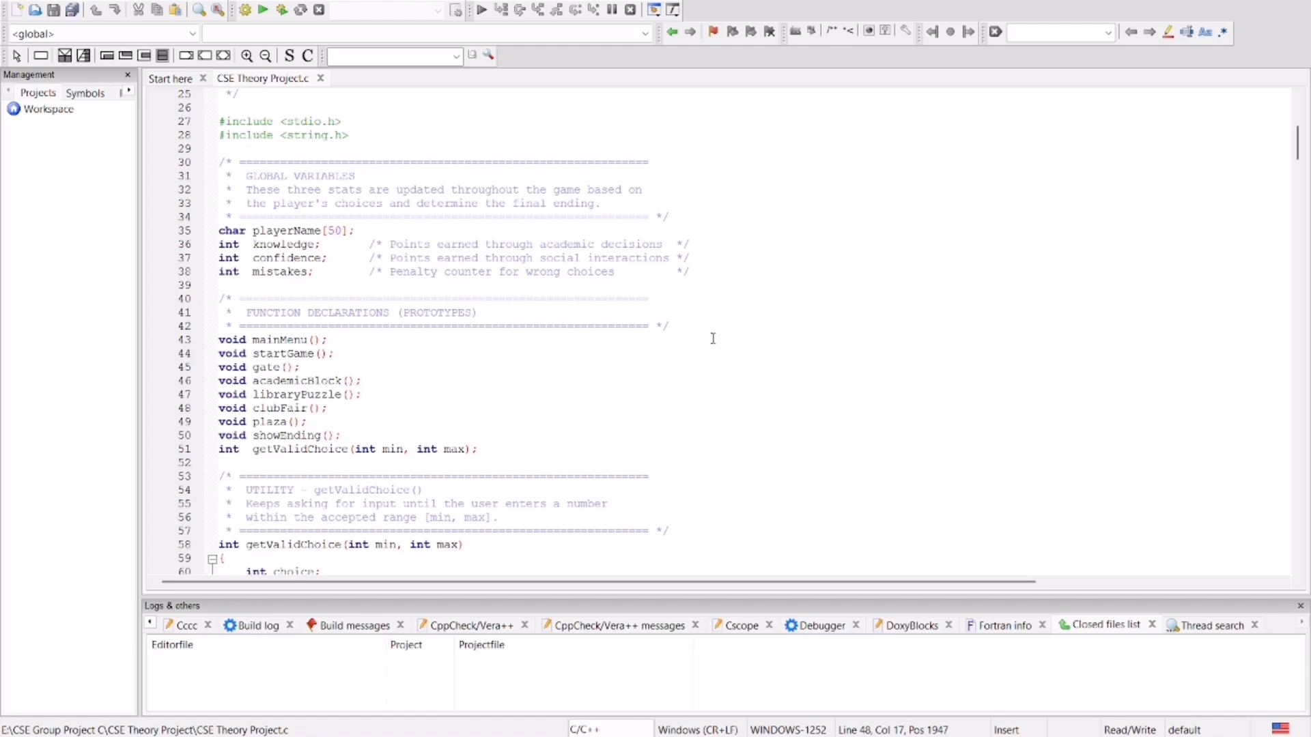
● LIVE DEMO
LIVE DEMO
NSU Campus Adventure — Gameplay Demonstration
🎮
[ Video / Live Terminal Demo Goes Here ]
Group 1 - Md. Shaharear Hossain Naffiz | Chowdhury Rounak Jahan Bushra | Sumaiya Karim Ilma | Smita Elizabeth Biswas

